Slide 1
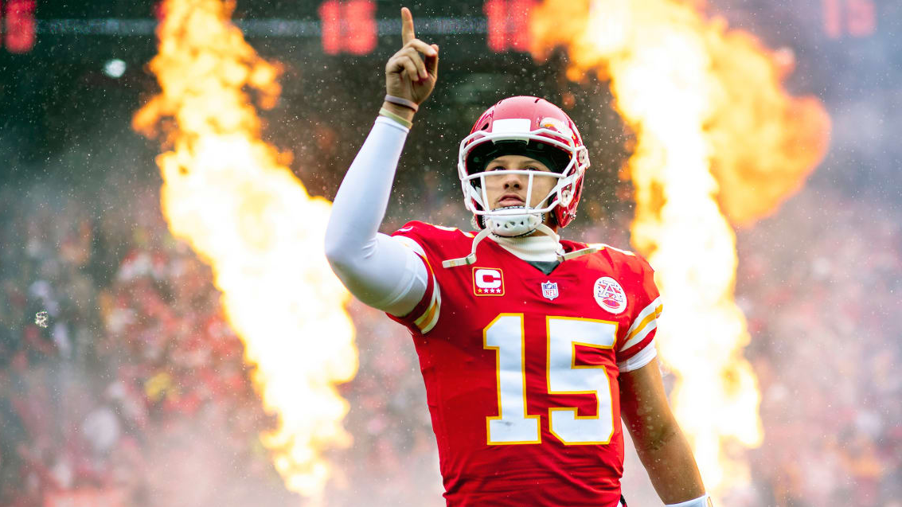
Unveiling NFL Insights through Statistics, Spreads and Data Analytics
TEAM
2
PROJECT NO. 4
GAME
CHANGER
01
02

Slide 2



TEAMWORK
THE ROSTER
DATA
CLEANING
VISUAL-IZATIONS
VISUAL-IZATIONS
LOUIS FERRANTE
JONAH FOEDAY
BRITTNEY HILL
01
02

Slide 3

TEAMWORK
THE ROSTER
CONTINUED
VISUALIZATIONS
PRESENTATION
Machine Learning
ALYSA
SCHOENFELDER
RYLAND WHELISS
01
02

Slide 4

GAME PLAN
Develop a machine learning model to forecast the winning NFL football team
PROJECT NO. 4
01
02

Slide 5
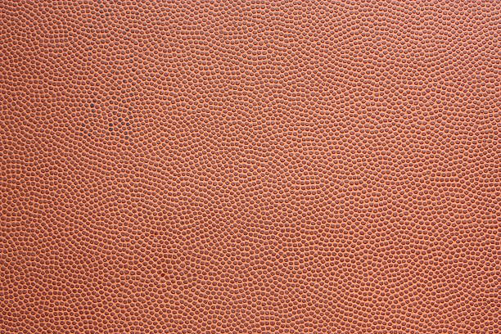

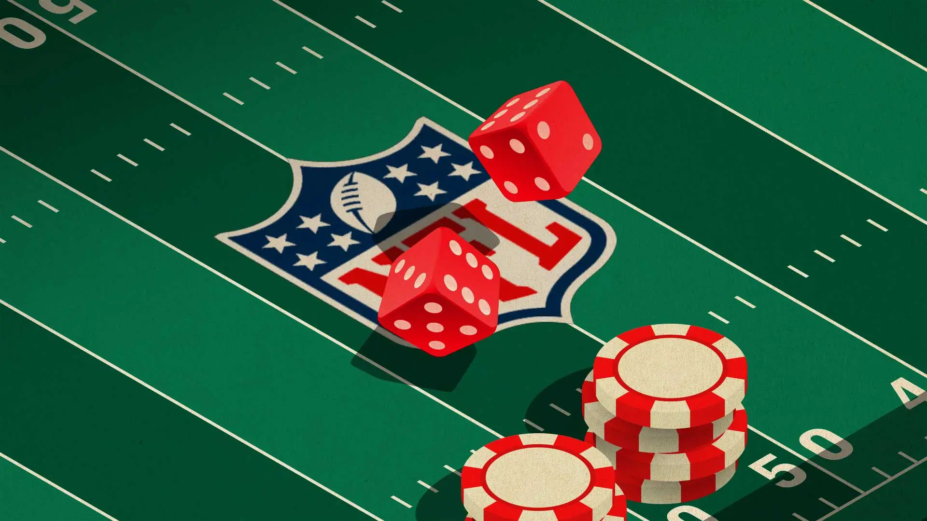
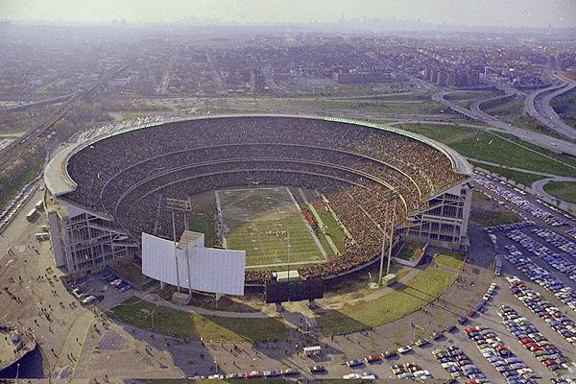

DATA DRAFT
01
GAME / SPREAD
STADIUMS
TEAMS
01
02
03
02

Slide 6

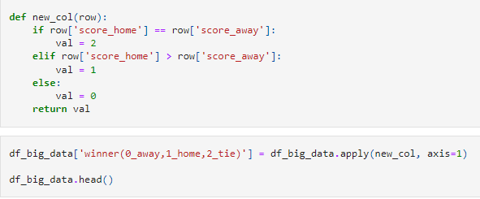


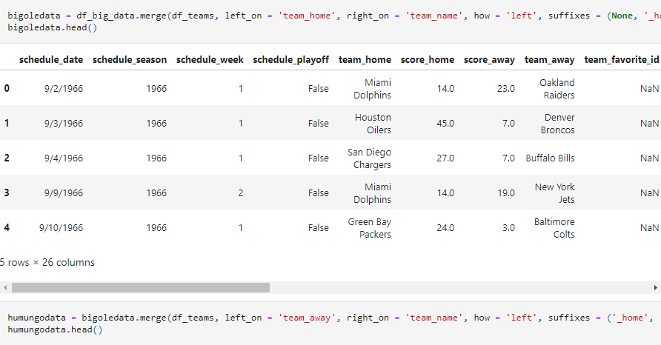
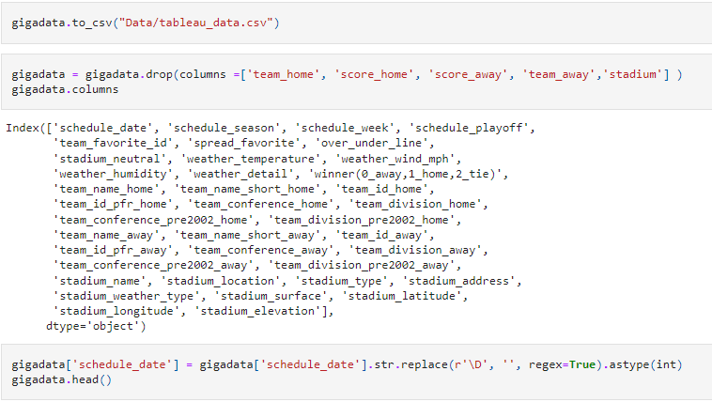

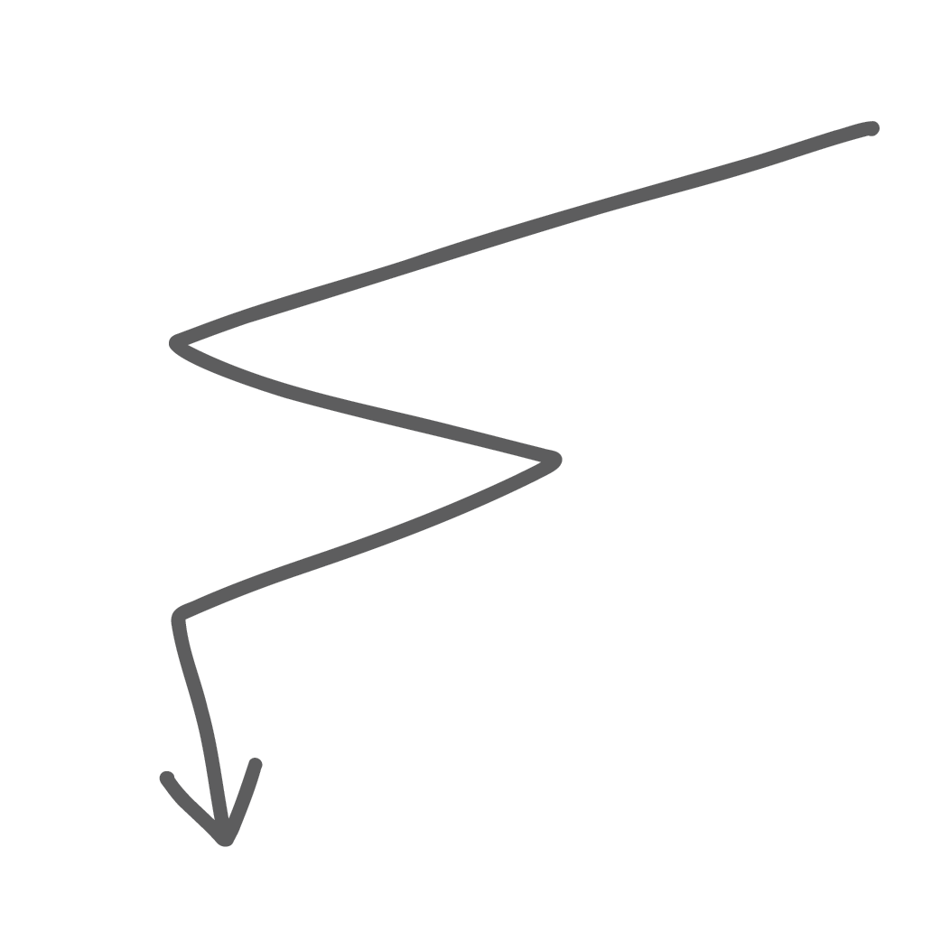


CONDITIONING
01
CEO
02

Slide 7
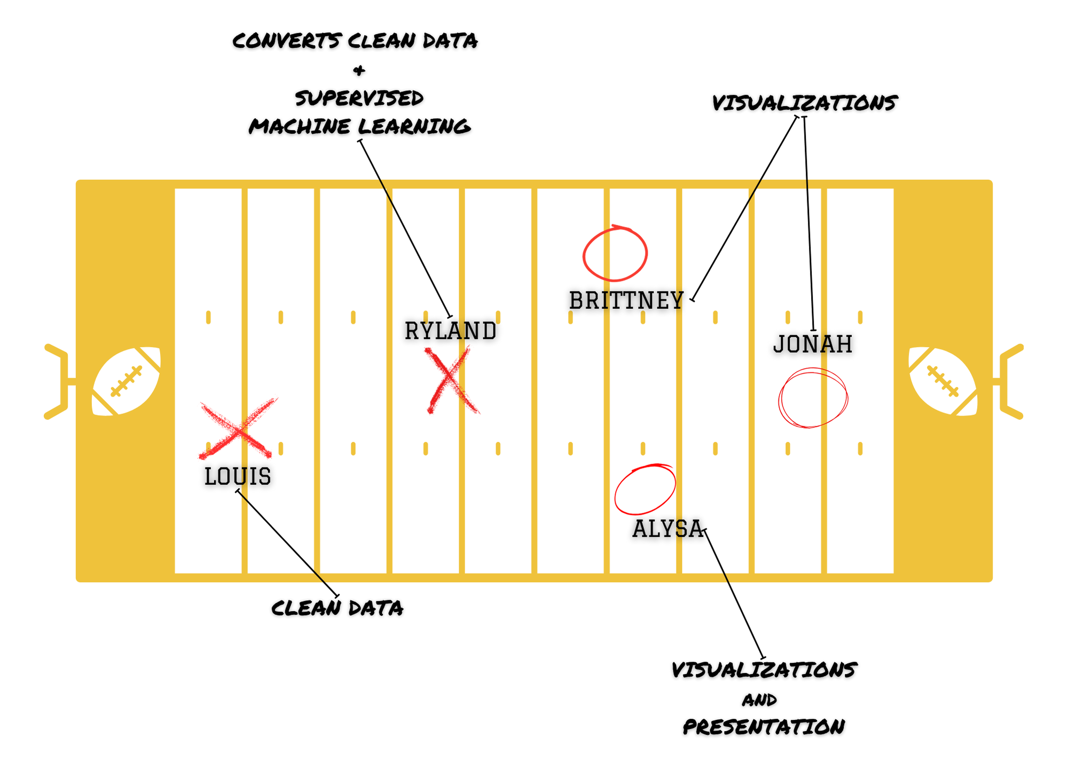






PLAYBOOK
01
02

Slide 8
TOUCHDOWNS
+ trends
01
02

Slide 9
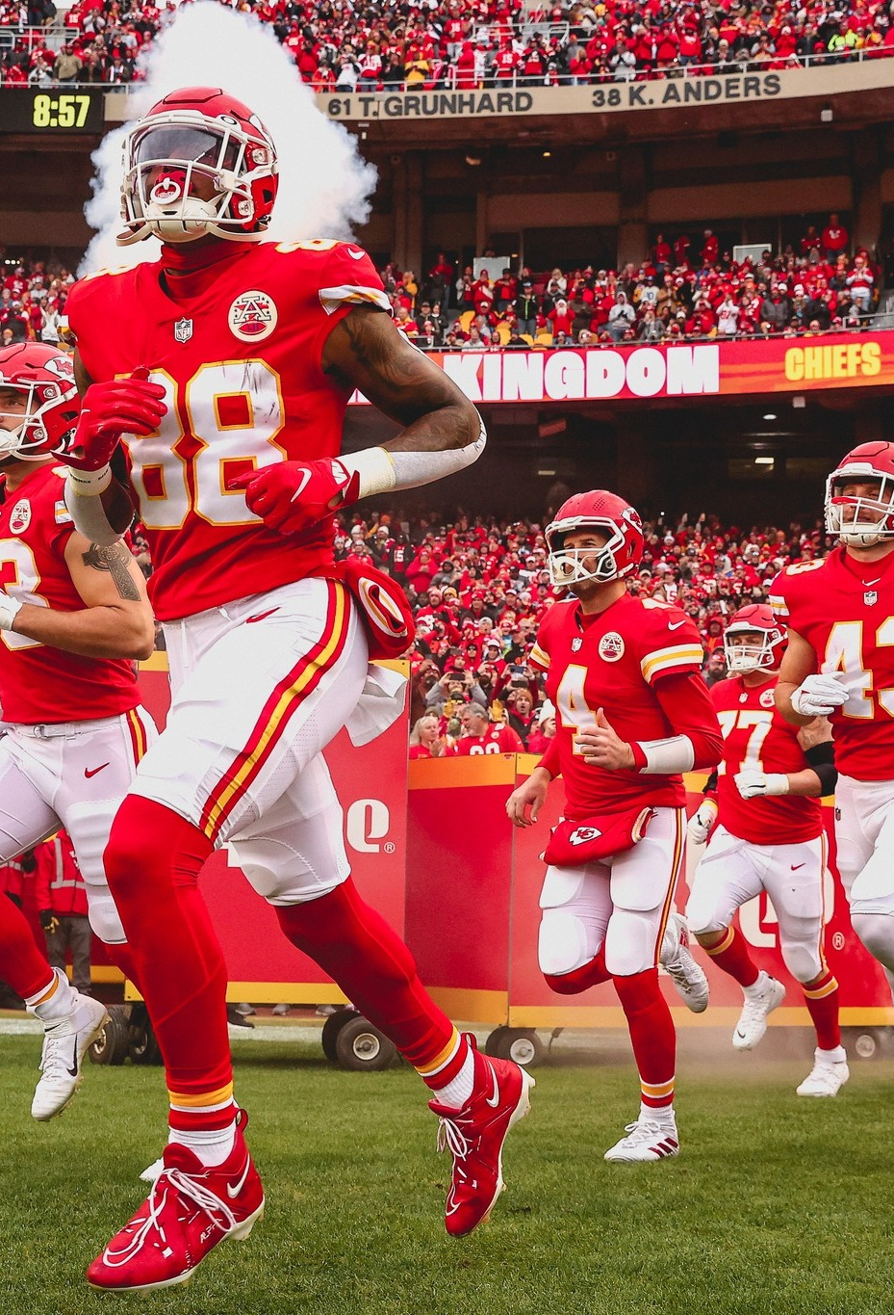
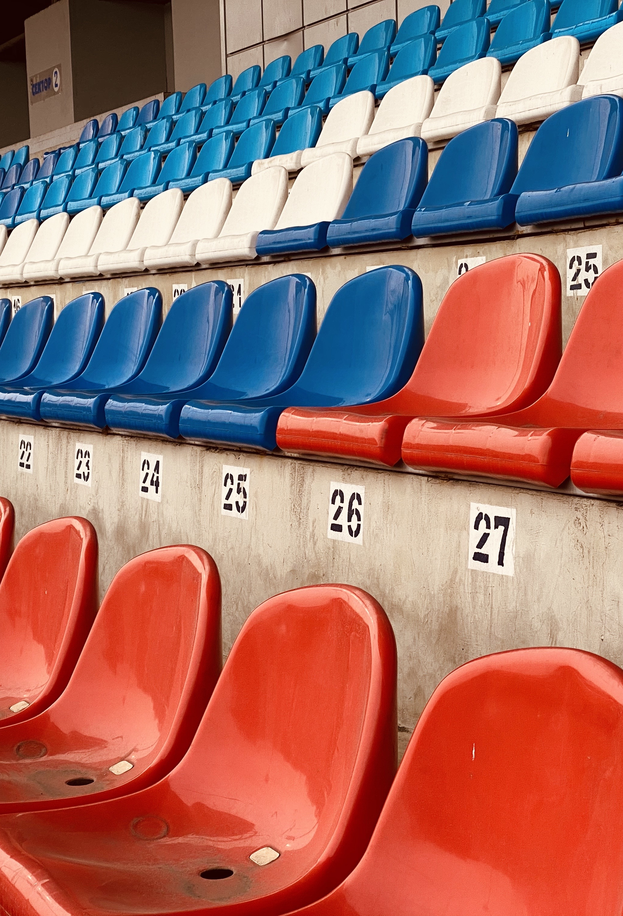
QUESTION NO. ONE
What can we learn from the history and changes of NFL teams by looking at their stadiums?
01
02

Slide 10
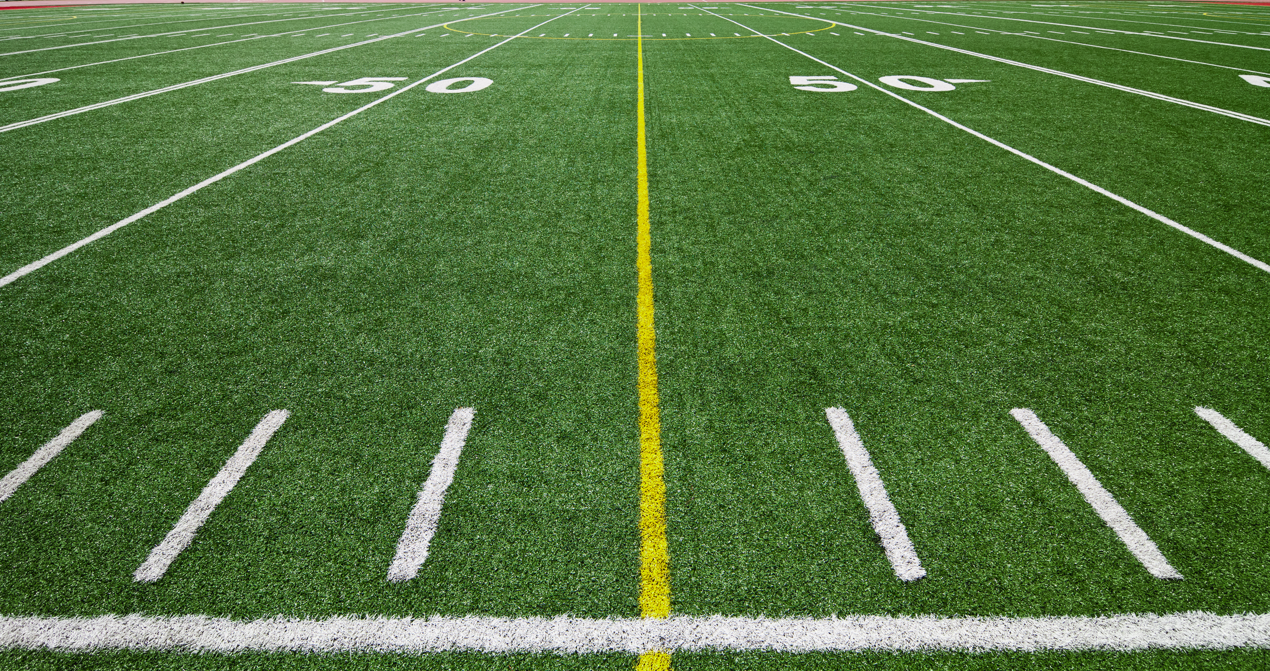
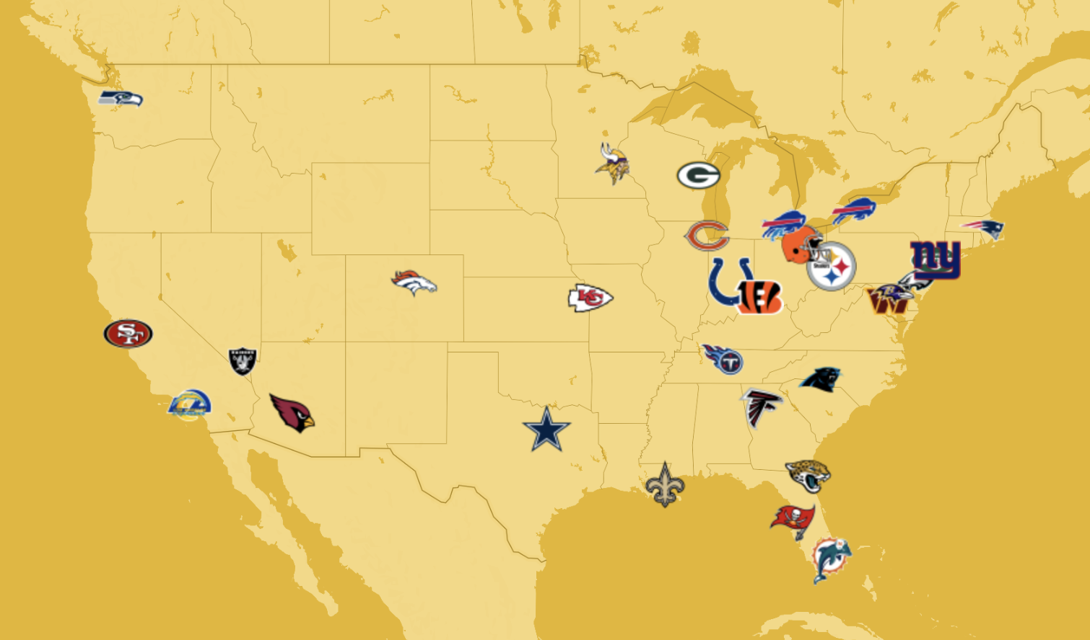
01
02

Slide 11
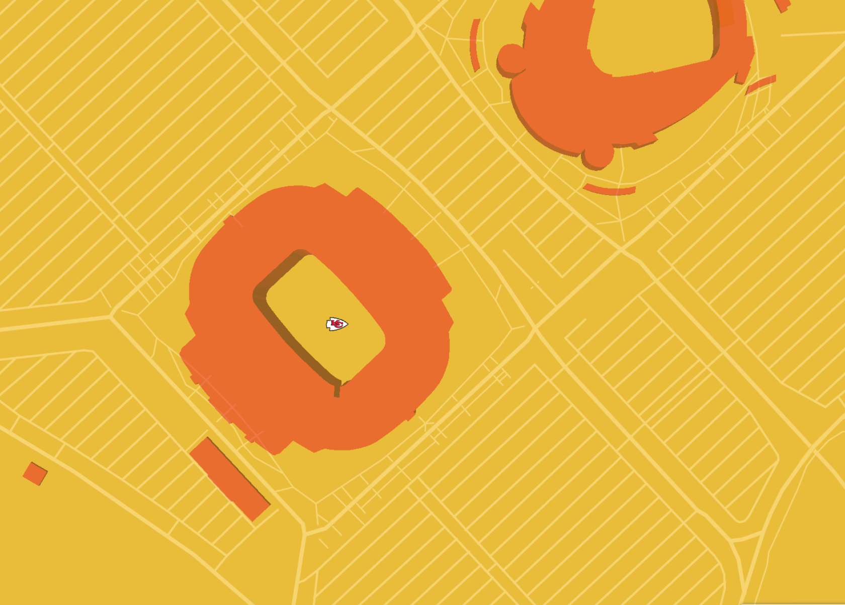
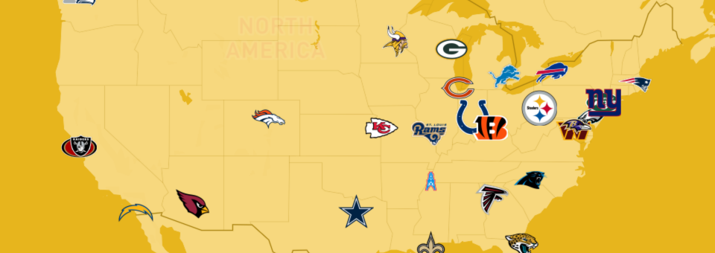


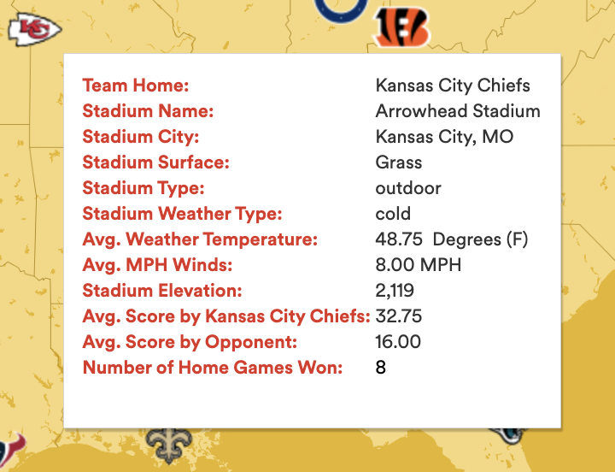
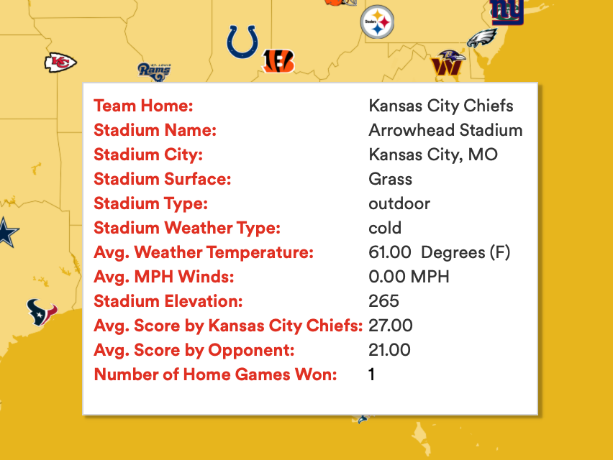

01
02

Slide 12
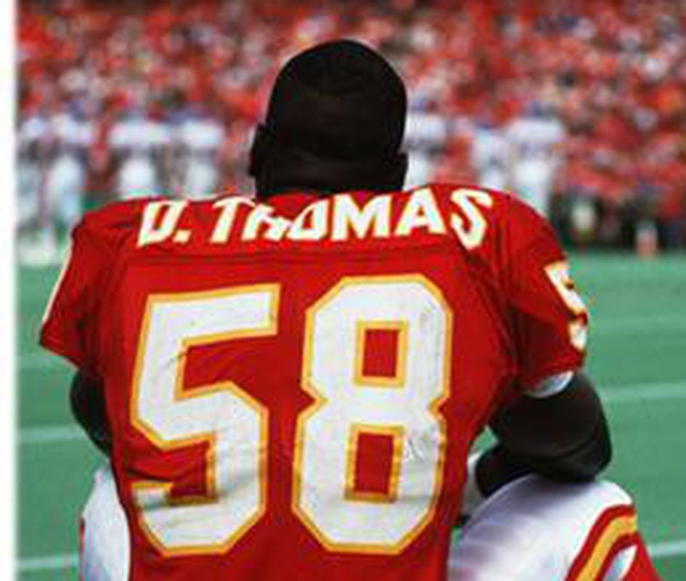
QUESTION NO. TWO
How much does “Home Field Advantage” Affect Scoring throughout scheduled weeks? SEASONS?
01
02

Slide 13
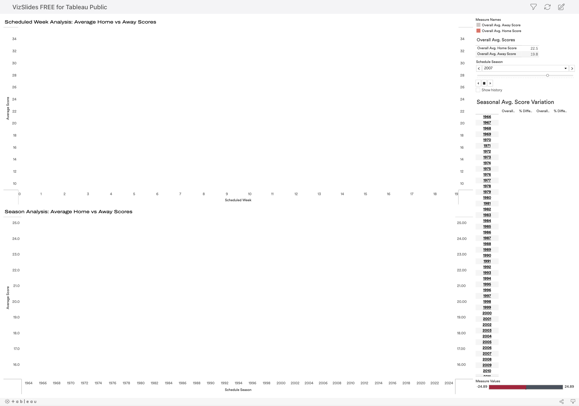
01
02

Slide 14
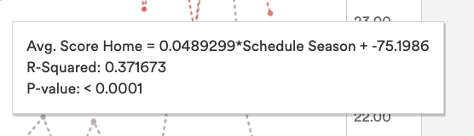
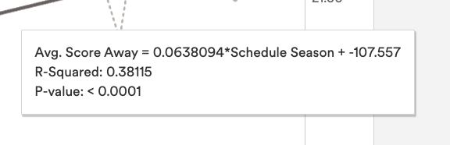
Annual increase: 0.049 points
One-point increase: ~20.4 years
Linear relationship explains 37.17% variability in home team scores
P-value < 0.0001: Strong statistical association with schedule season
H
O
M
E
Annual increase: 0.064 points
One-point increase: ~15.7 years
Linear relationship explains 38.12% variability in home team scores
P-value < 0.0001: Strong statistical association with schedule season
A
W
A
Y
01
02

Slide 15
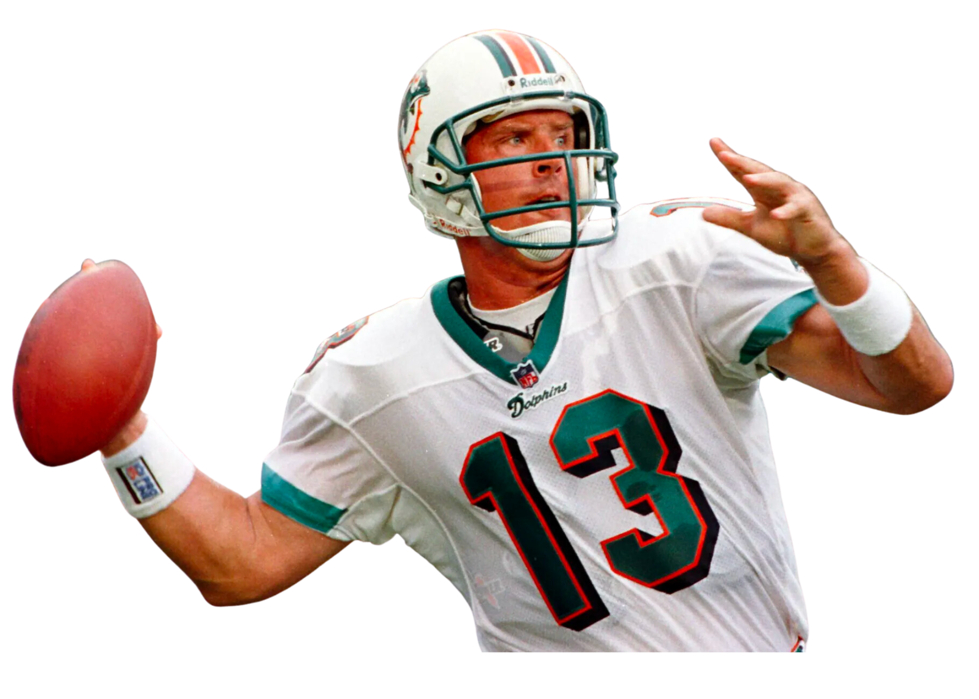
QUESTION NO. 3
Can the Game’s Outcome be affected by Whether a team plays at home or away?
01
02

Slide 16
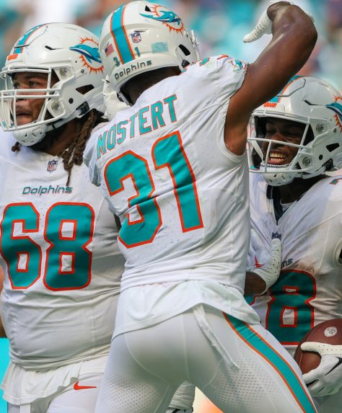
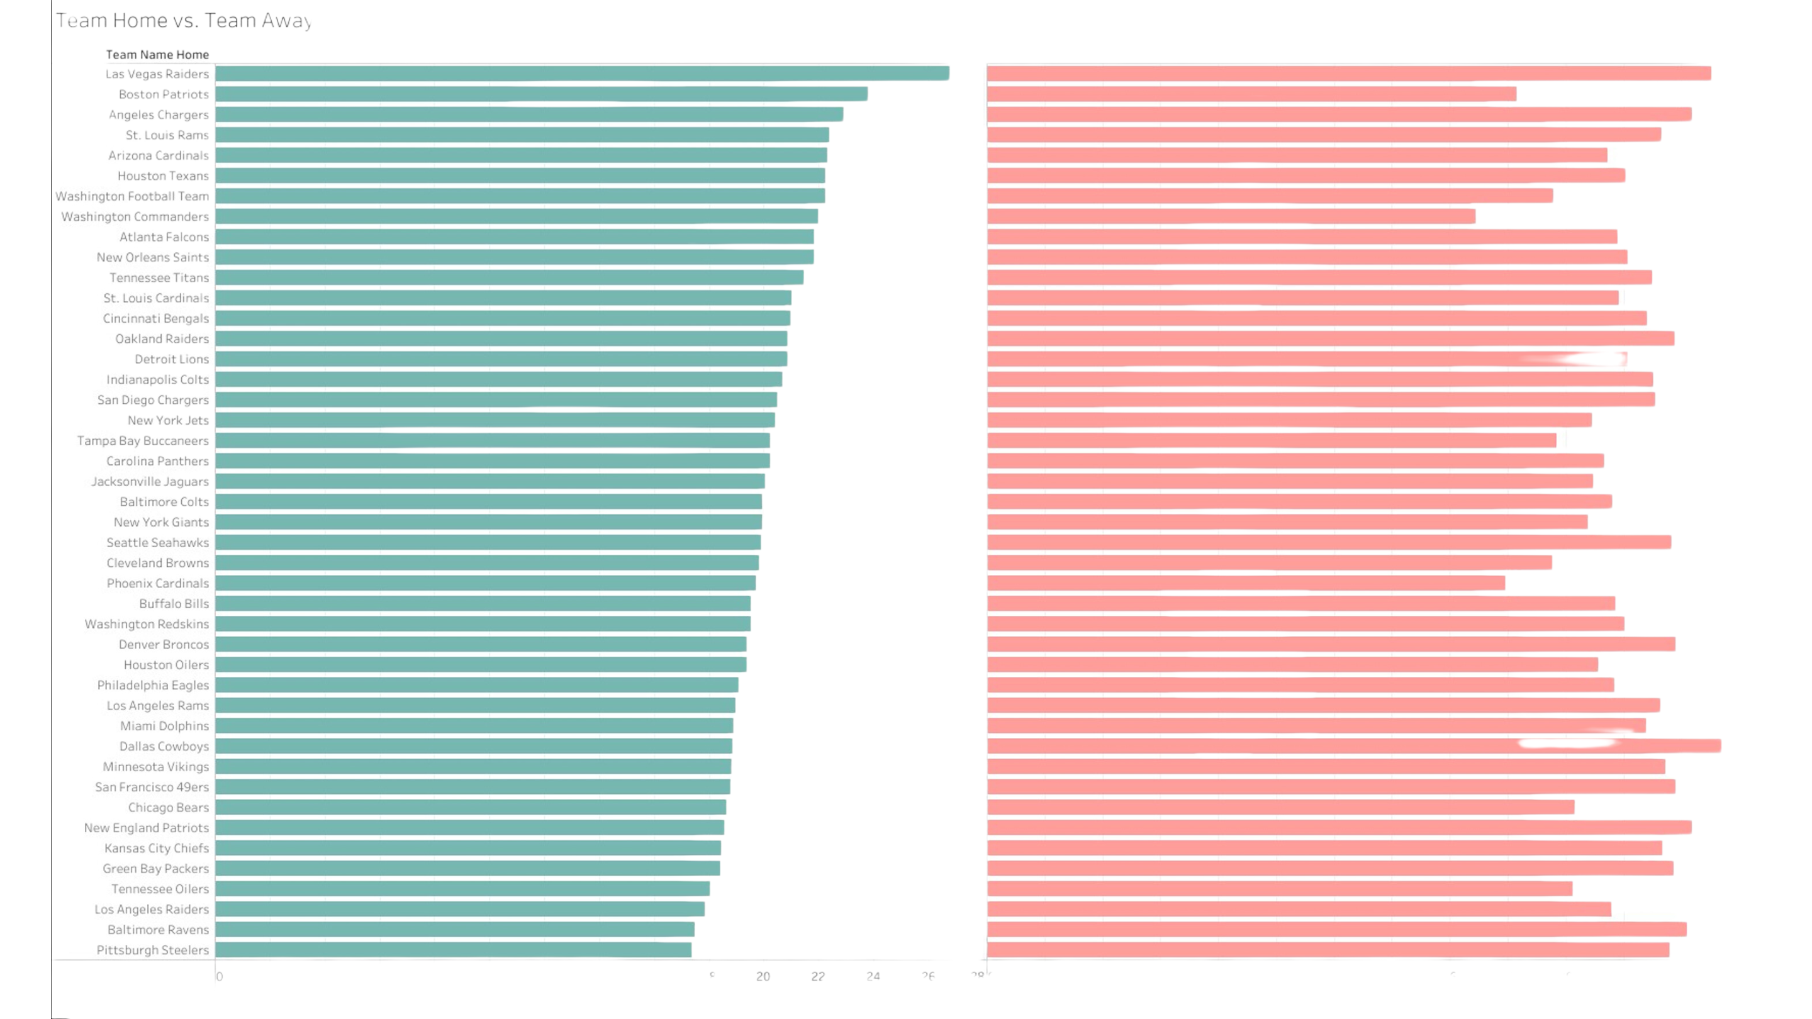

Slide 17
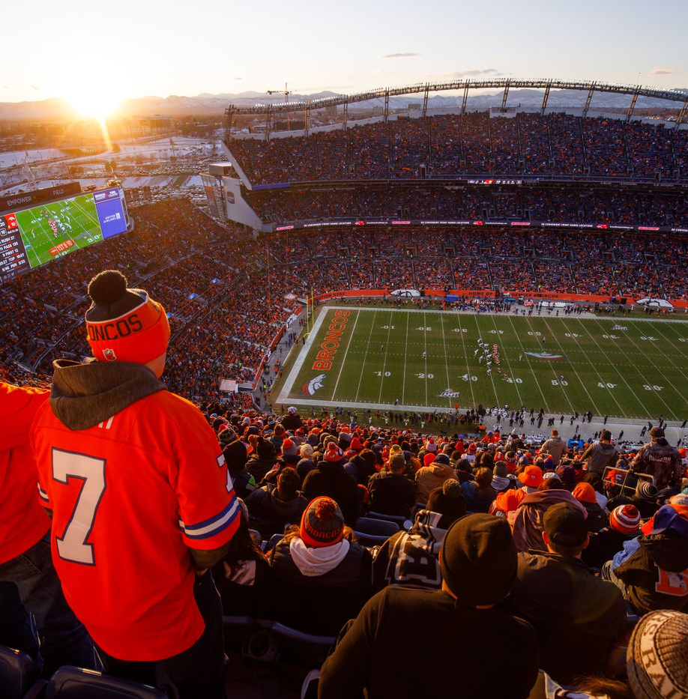
QUESTION NO. FOUR
Does STADIUM ELEVATION AFFECT WHO WILL WIN THE FOOTBALL GAME?
01
02

Slide 18
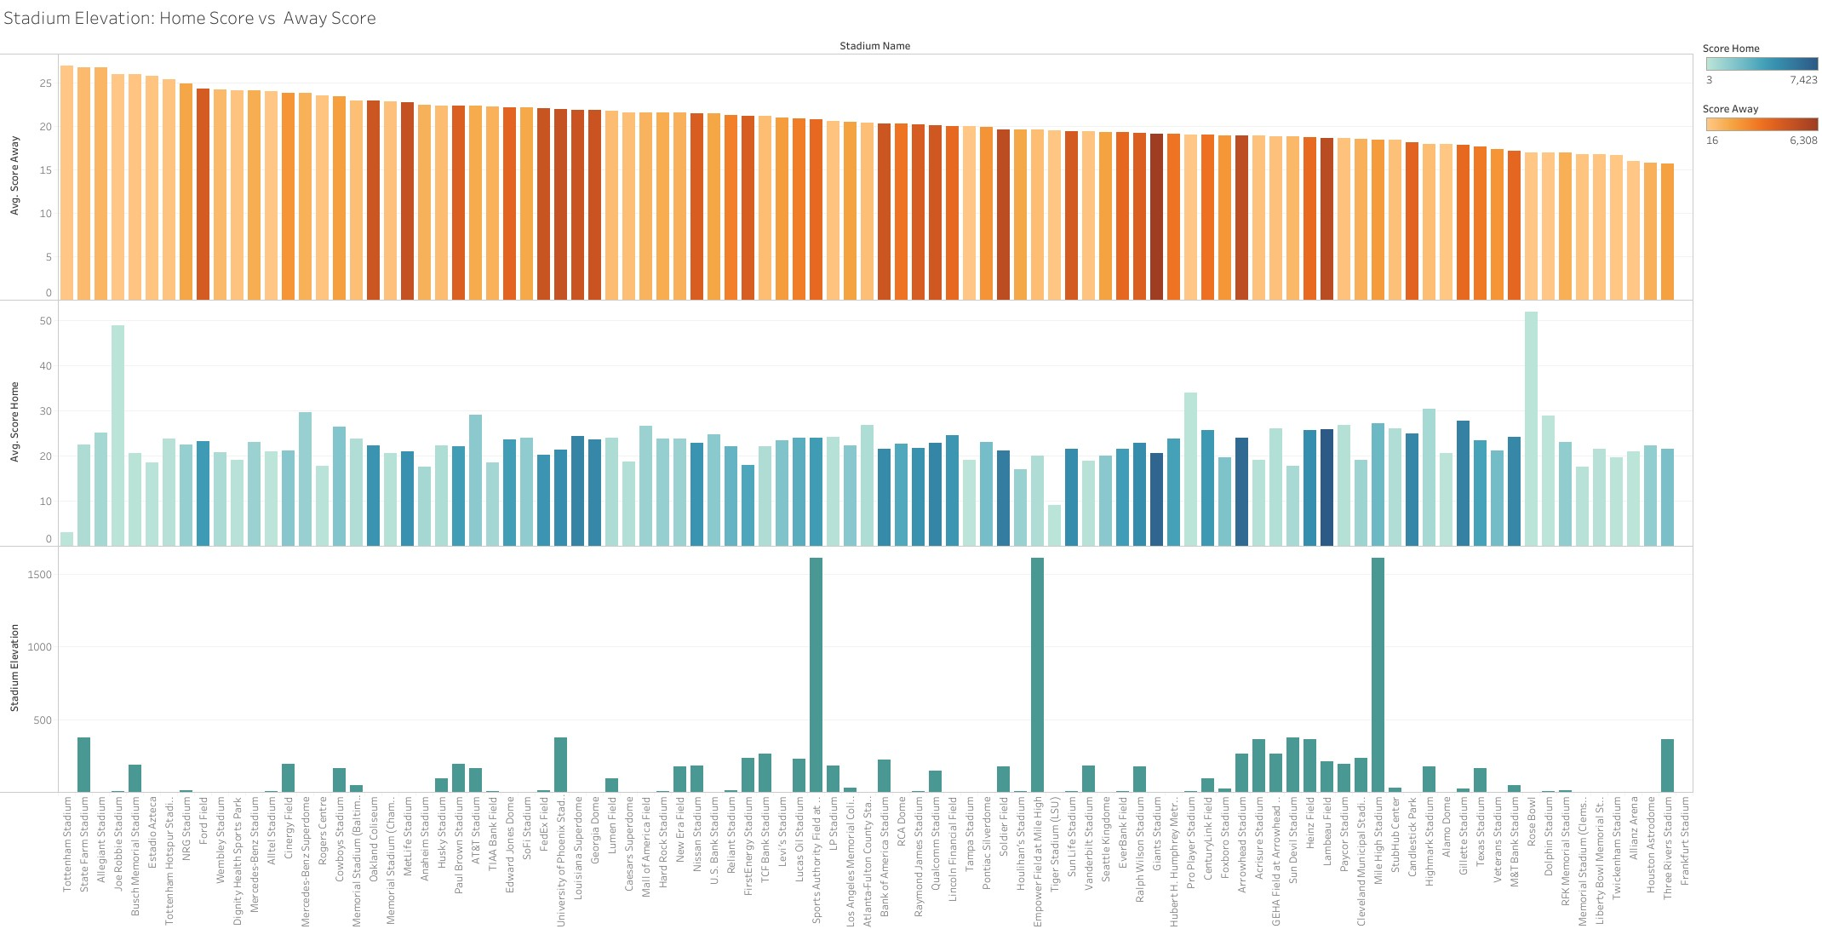

Slide 19
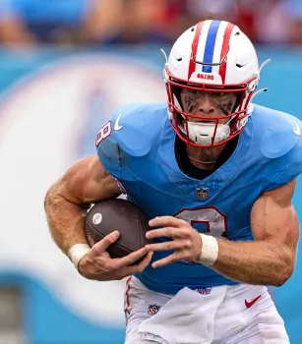
QUESTION NO. FOUR
HOW DOES SPREAD AFFECT WHO WILL WIN THE GAME?
01
02

Slide 20
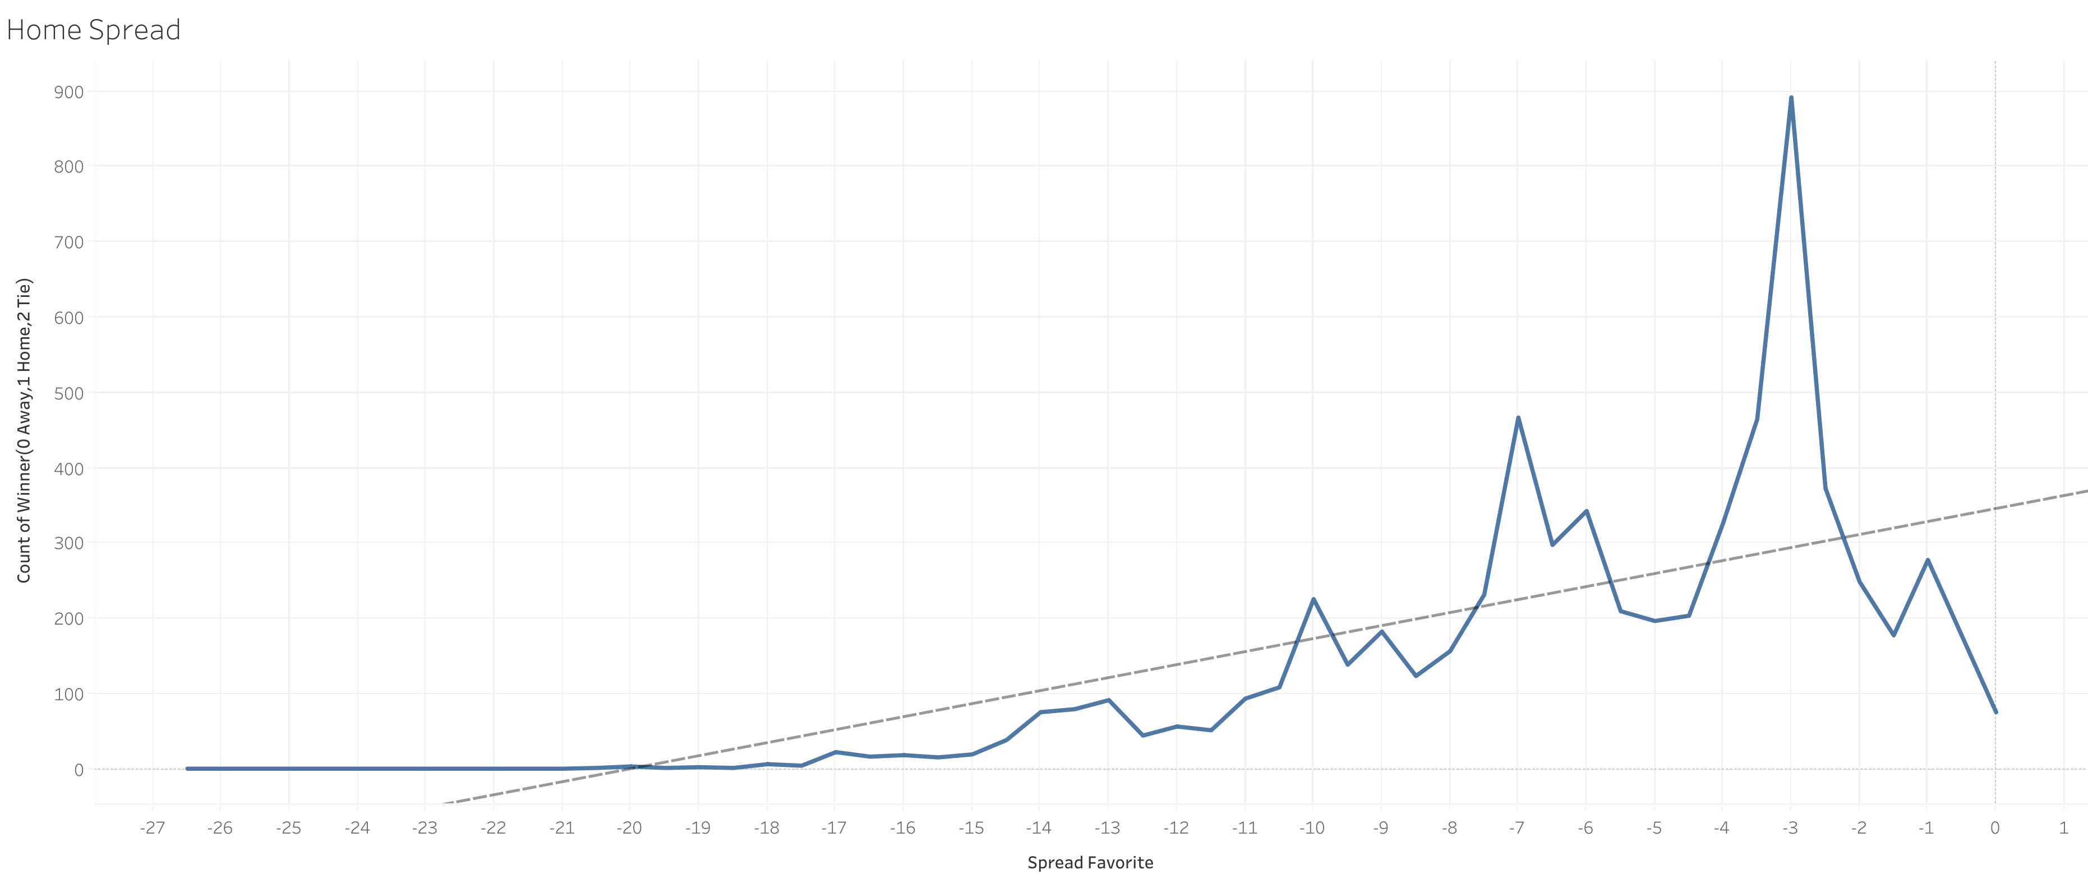
HOME SPREAD

Slide 21
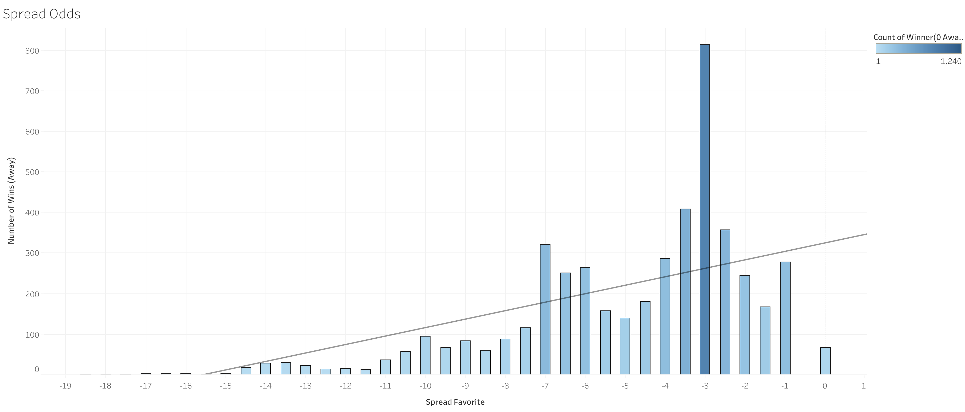
AWAy SPREAD

Slide 22
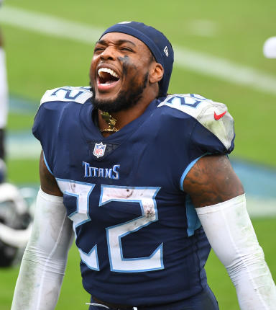
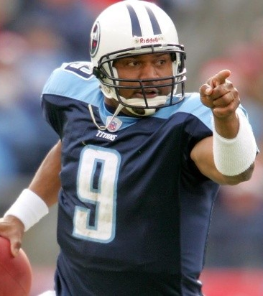
MACHINE
LEARNING

Slide 23
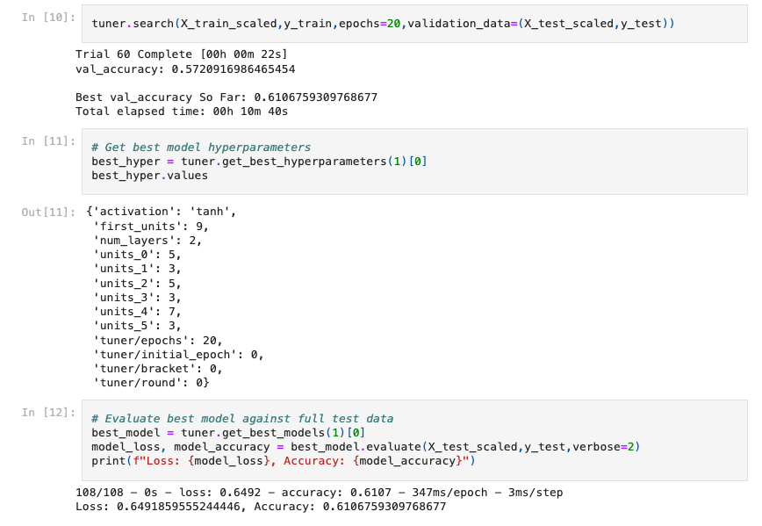
@BISTRO
MOCKUP
SUPERVISED MACHINE LEARNING
01
02

Slide 24

MACHINE LEARNING
RESULTS
64.9%
LOSS
61.1%
01
ACCURACY
02

Slide 25
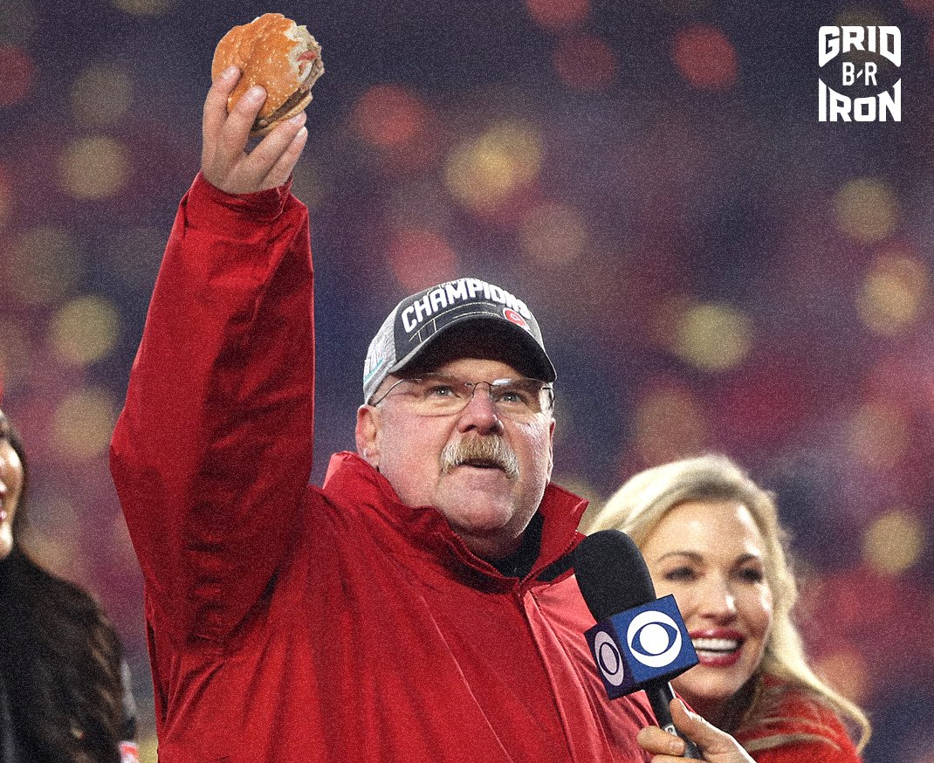
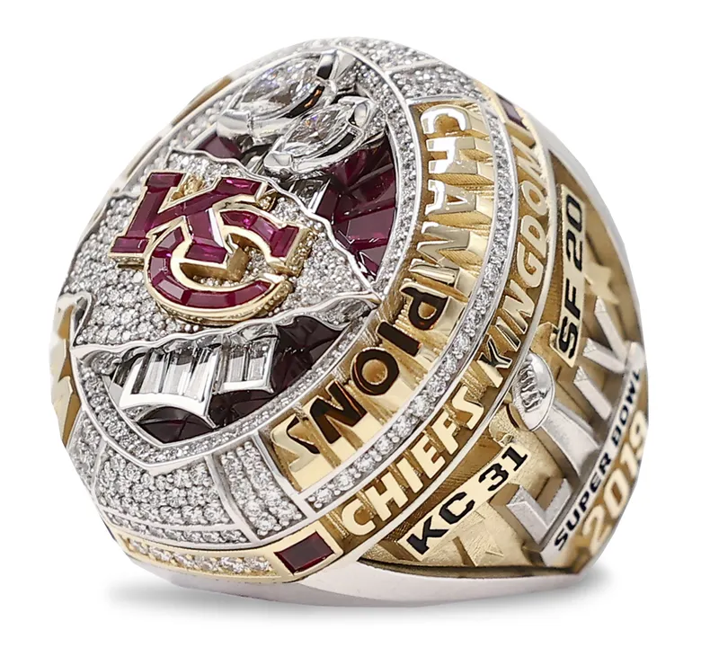
t
”I'm going to get the biggest cheeseburger you can find, might make it a double.”
-ANDY REID-
SUPERBOWL LIV RING
2020

Slide 26

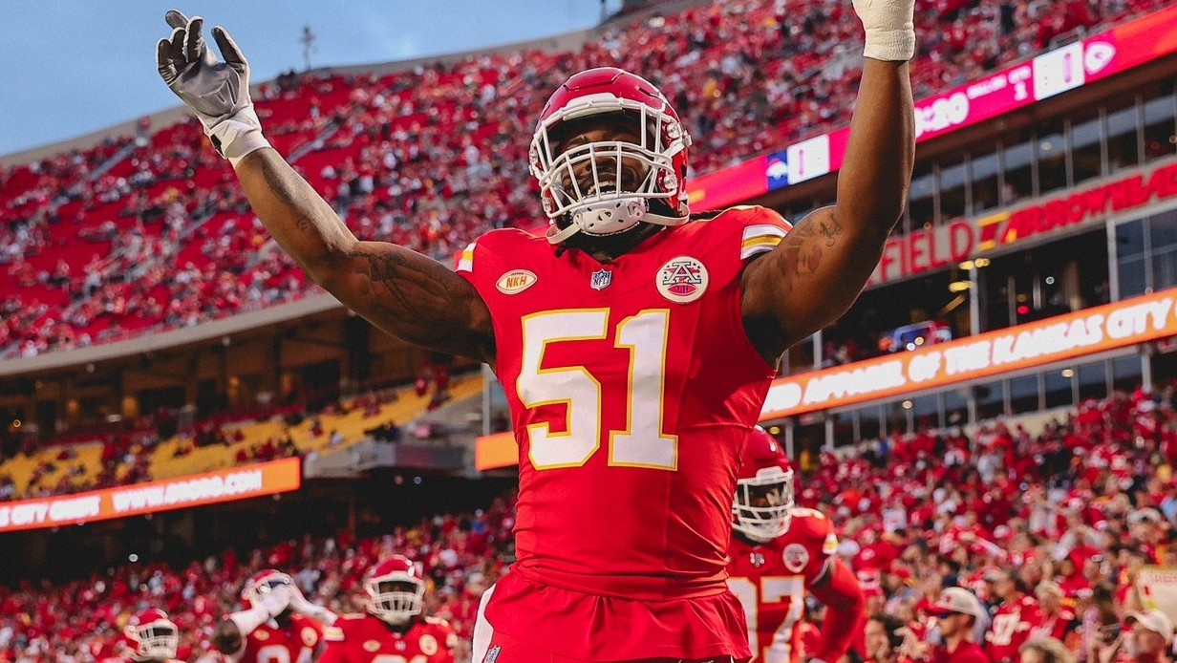
01
02

Slide 27
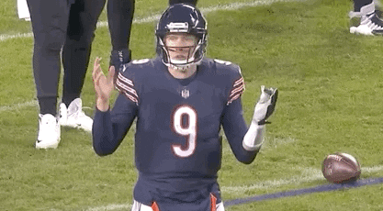
ANY QUESTIONS
?
01
02

